Slide 1

UNIX - Fundamentals
7
Simple Filters
9
SED
5
The shell
cmp comm diff head and tail …
Inserting
Updating
Deleting
RegEx….
1
UNIX Intro
3
Unix File System
Pattern matching
Escaping Redirecting…
The UNIX OS
The Linux OS
Features of Unix
The file
pwd and cd
mkdir
ls and cp ..
Shell Programming
8
GREP
10
6
The Processes
The character class
The *
The Dot…
condition eval
loops
read
exit status
4
Vi/Vim editors
ps nohup at and batch
2
Unix Commands
Input mode
Saving text
Aborting…
command basics
man
echo
printf …
Biz Nigatu
Software Engineer and Instructor
reckonedforce.com
@bizNigatu

Slide 2
Section 7 – UNIX Fundamentals
‘pr’ – paginate files
‘cmp’ – compare two files
‘diff’ – compare two files
‘comm’ – compare two files
‘head’ – display the file top
‘tail’ – display the file bottom
‘cut’ – slitting a file vertically
‘paste’ – pasting files
‘sort’ – ordering a file
‘tr’ – translating characters

Slide 3
Chapter 9 - *** Simple Filters

Slide 4
‘pr’ Paginating Files
Prepares a file for printing by adding headers, footers, and formatted text
When used with a filename as an argument, pr doesn’t behave like a filter
Adds five lines of margin at the top and five at the bottom
Header shows the date and time of last modification of the file
‘pr’ has several options which can be combined to provide the desired effect

Slide 5
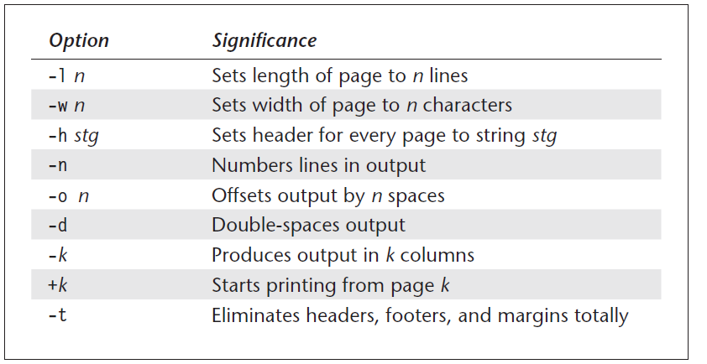
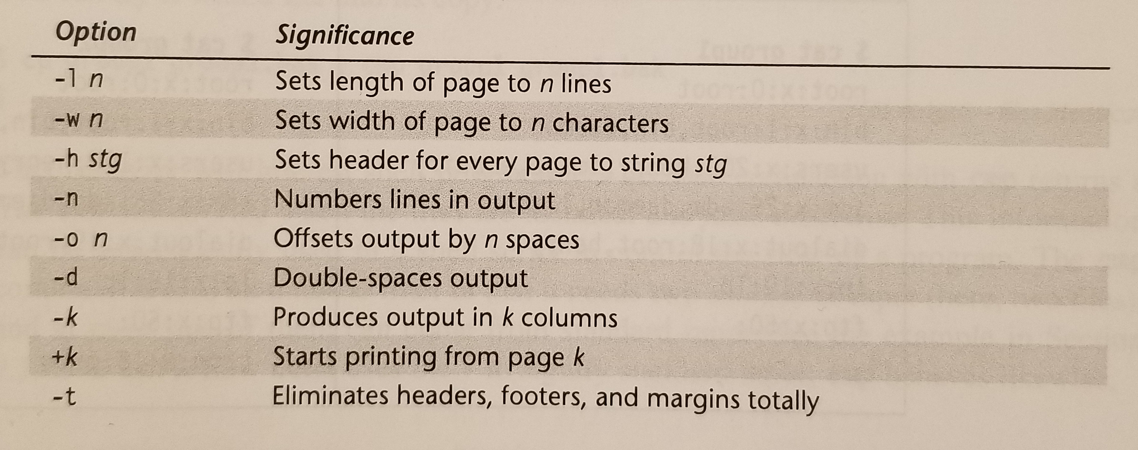
‘pr’ Options

Slide 6
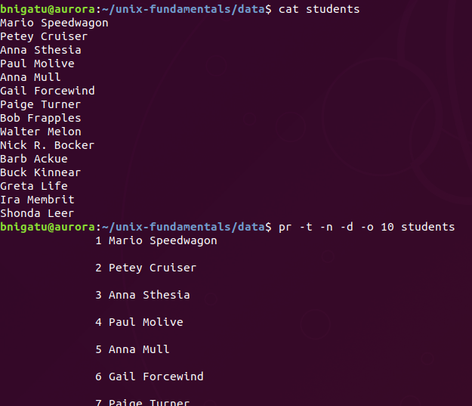
‘pr’ Example
-n = number output line
-d = double space
-o 10 = offset 10 spaces

Slide 7
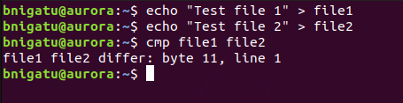
‘cmp’ Byte-by-Byte Comparison
‘cmp’ does a byte-by-byte comparison, e.g. character-by-character
Echoes the location of the first mismatch
By default, does not bother about possible subsequent mismatches

Slide 8
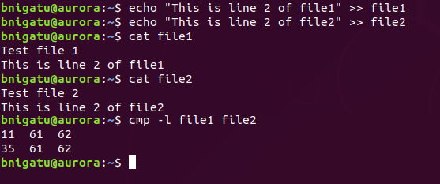
‘cmp’ Example
Can display list of subsequent mismatches using the ‘-l’ option:
If the two files are identical, ‘cmp’ displays no messages

Slide 9
‘comm’ What Is Common
While cmp compares two files character by character, comm compares them line by line
and displays the common and differing lines. Also, comm requires both files to be sorted.
‘comm’ requires both files to be sorted
‘comm’ compares the files and displays the common and differing lines
Column 1 Lines unique to the first file
Column 2 Lines unique to the second file
Column 3 Lines common to both files

Slide 10
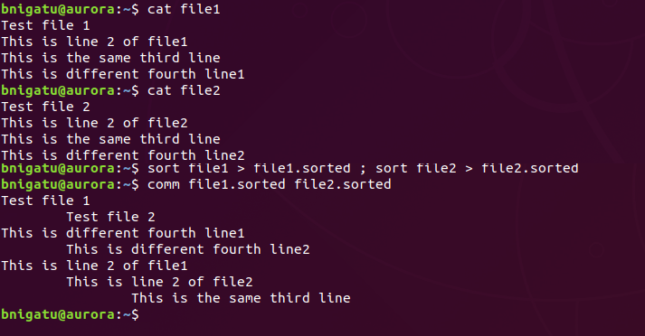
‘comm’ Example
Column 1
Column 2
Column 3

Slide 11
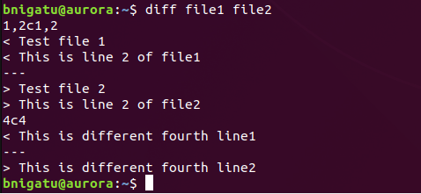
‘diff’ Converting One File to Another
Unlike the other two commands, ‘diff’ tells you which lines in one file have to be changed to make the two files identical:
Line 1 and 2 need to be changed to match 1-2 in the other file
< means ‘lines from first file’
--- denotes separation of the files
> means ‘lines from second file’

Slide 12
‘diff’ Continued
‘diff’ outputs a set of instructions for how to change one file to make it identical to the second file
Lines preceded by a < are lines from the first file
Lines preceded by > are lines from the second file
The three dashes ("---") merely separate the lines of file 1 and file 2
‘diff’ can optionally generate a script (with the -e option) for the program ed (or ex which can be used to apply the changes)
Examples show the default output of diff – output is intended to be read by a computer, not a human

Slide 13
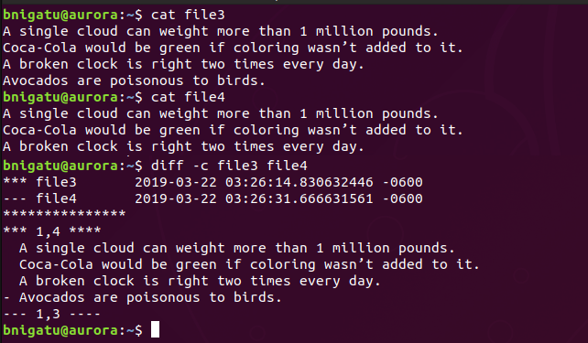
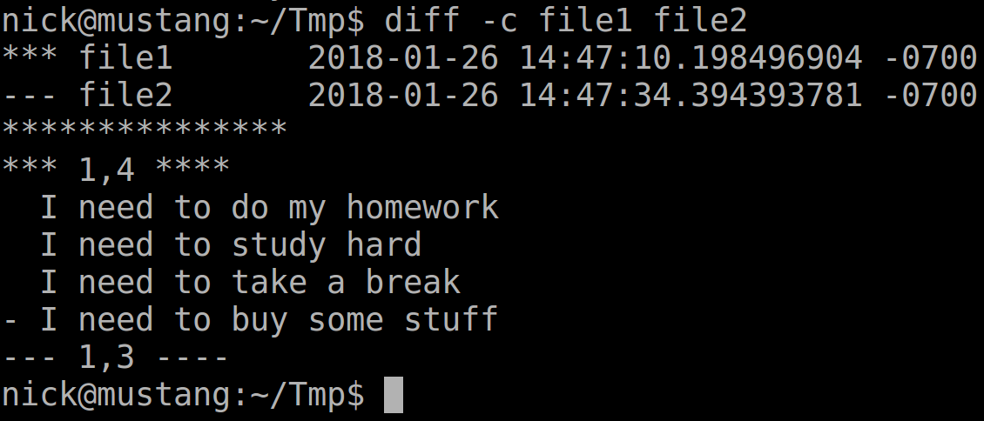
‘diff –c’ Example
Lists the file, name, modification date, and modification time of each of our files, one per line
*** from file --- to file
Just a separator
Lines to be added: ‘+’
Lines to be deleted: ‘-’
Line range, e.g. 1-4
Line to be deleted
Line range in the second file after

Slide 14
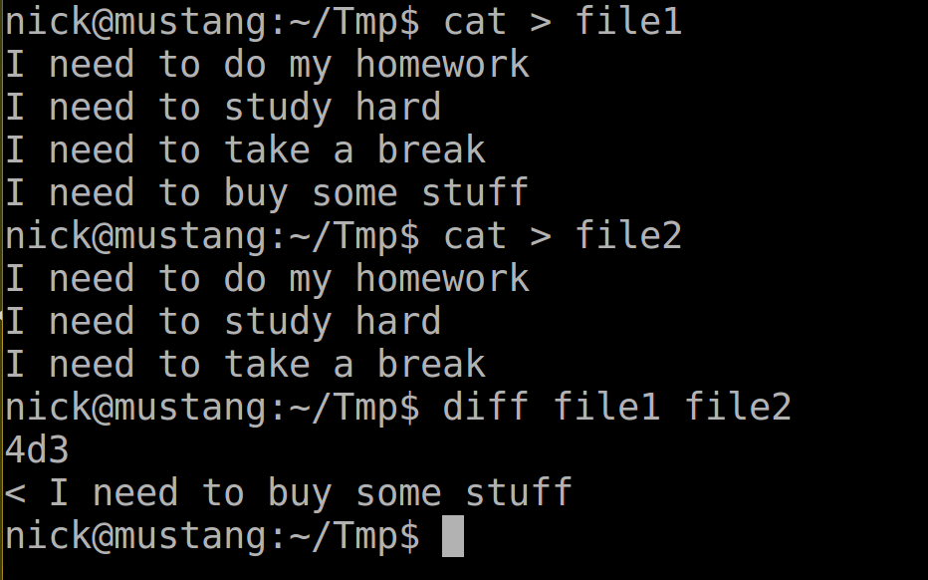
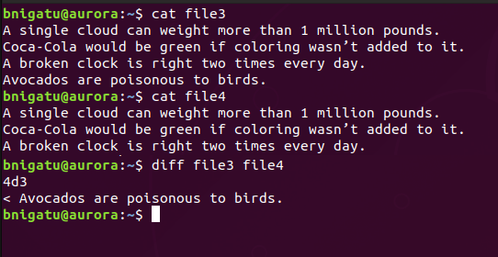
‘diff’ Example
Not in file4
After line 3 in the first file, delete line 4 to sync the files

Slide 15
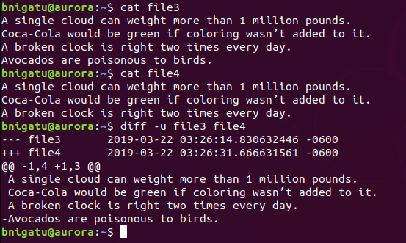
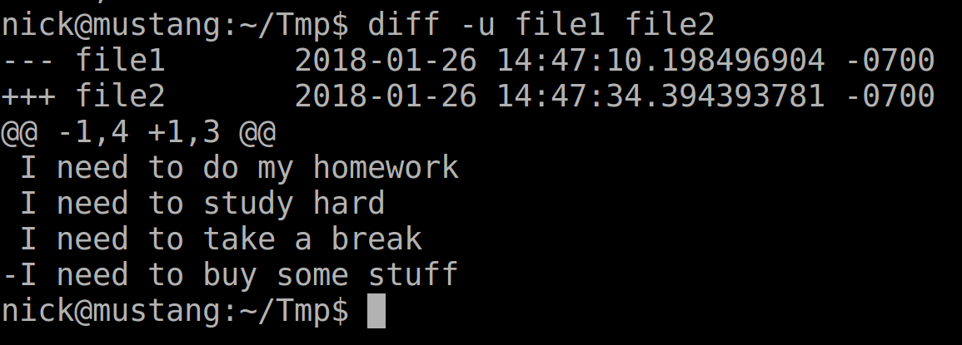
‘diff –u’ UNIFIED Example
diff –u give a more human readable output.
A patch file also can be generated from a unified output.
‘-’ file3 has 4 lines; ‘+’ file4 has three lines
Delete line 4 of file4

Slide 16
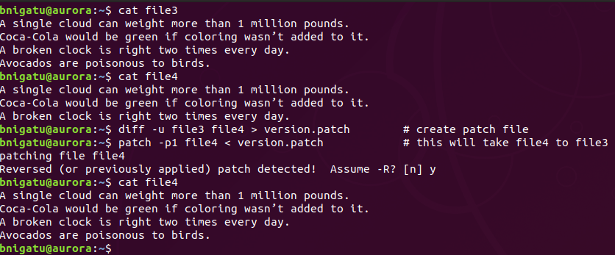
‘diff –u’ patch file Example
We could create a patch file and apply it to file3 or file4 to change one file from one to another.

Slide 17
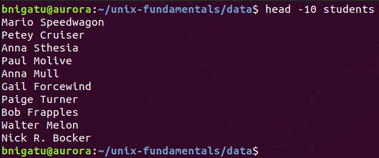
head: Displaying the Beginning of a File
We have used head together with the pipe ‘|’ but like ‘more’, ‘head’ can be used before such as ‘head –n 10 <filename>’ display first 10 lines:
‘-n’ says show the top 10 lines

Slide 18
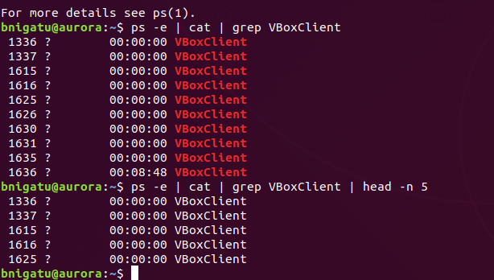
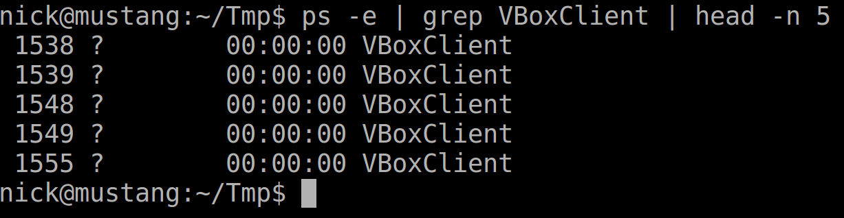
‘head –n’ Example
‘ps –e | grep VBoxClient | head –n 5’
‘ps –e’ displays ALL processes. Pipe the output to ‘grep’ and look for any process with VBoxClient.
Pipe the output to head but only show me the first 5 lines

Slide 19
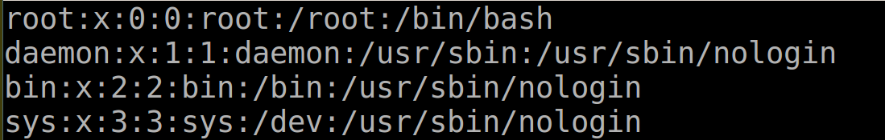
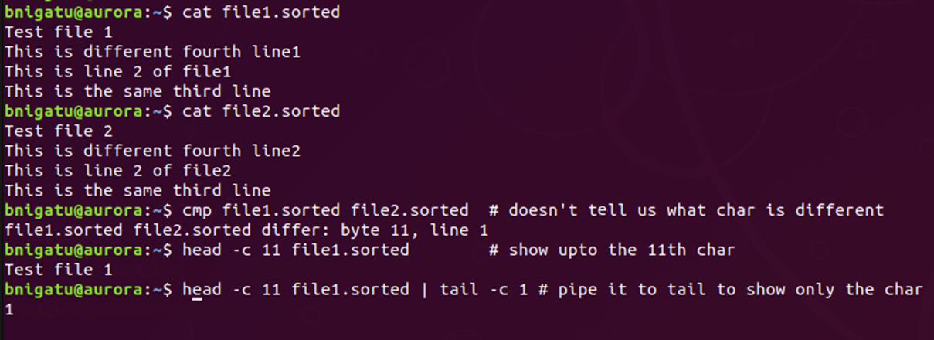
‘head –c’ Example

Slide 20
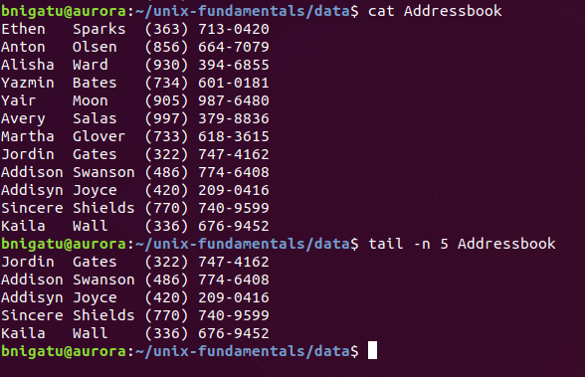
‘tail –n’ Example
Like head and history, tail can do more than just give you the last 10 lines
With the –n option, you can tell it how many lines you want to see:

Slide 21
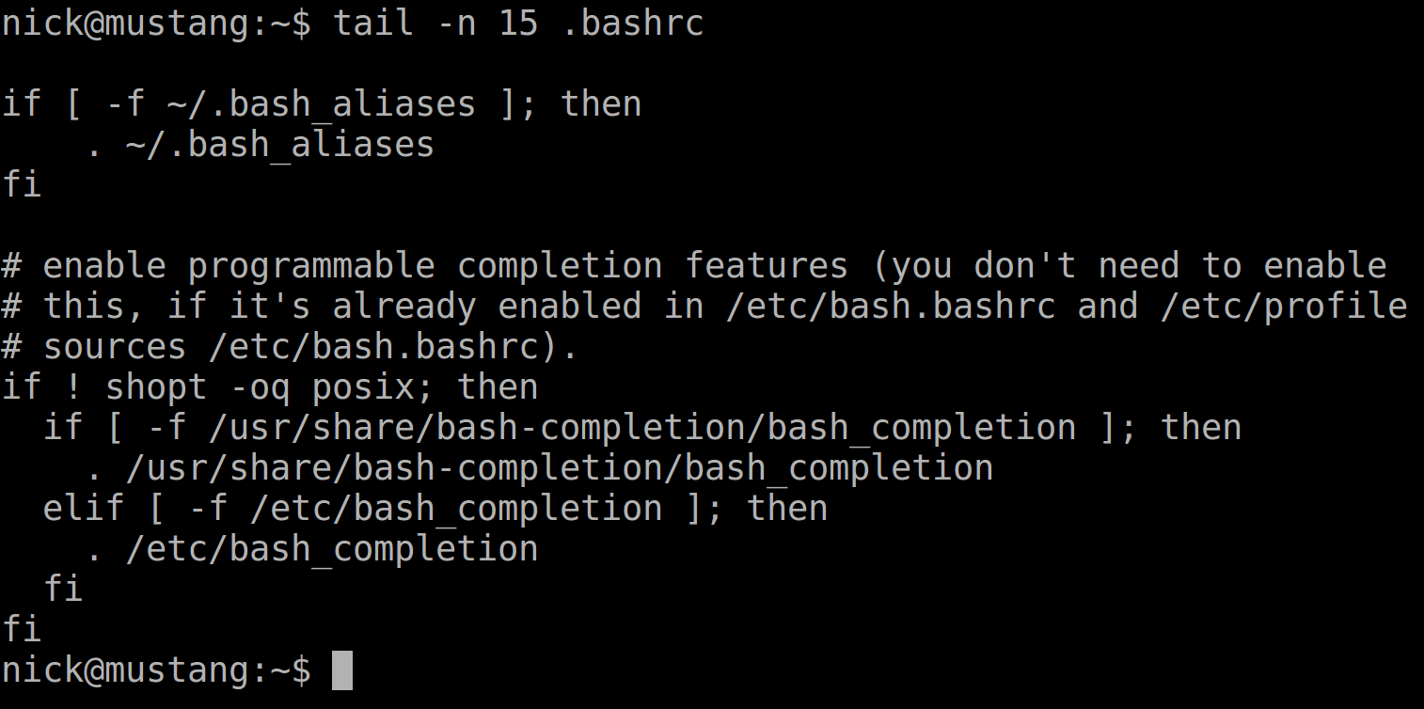

‘tail –c’ Example

Slide 22
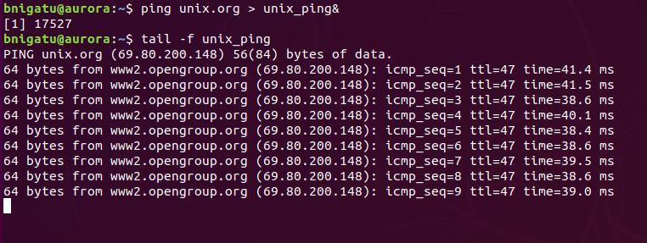
‘tail –f’ Example
tail –f monitors a growing file
The example below reads new logs added to file unix_ping added by a background ping process

Slide 23
cut: Slitting a File Vertically
While ‘head’ and ‘tail’ slice a file horizontally, you can slice a file vertically with the ‘cut’ command
‘cut’ identifies both columns and fields
To cut columns, use the ‘-c’ option
EXERCISE:
‘mkdir tmp’
‘cp /etc/passwd tmp/pass’
‘cut –c 1-6 | more’

Slide 24
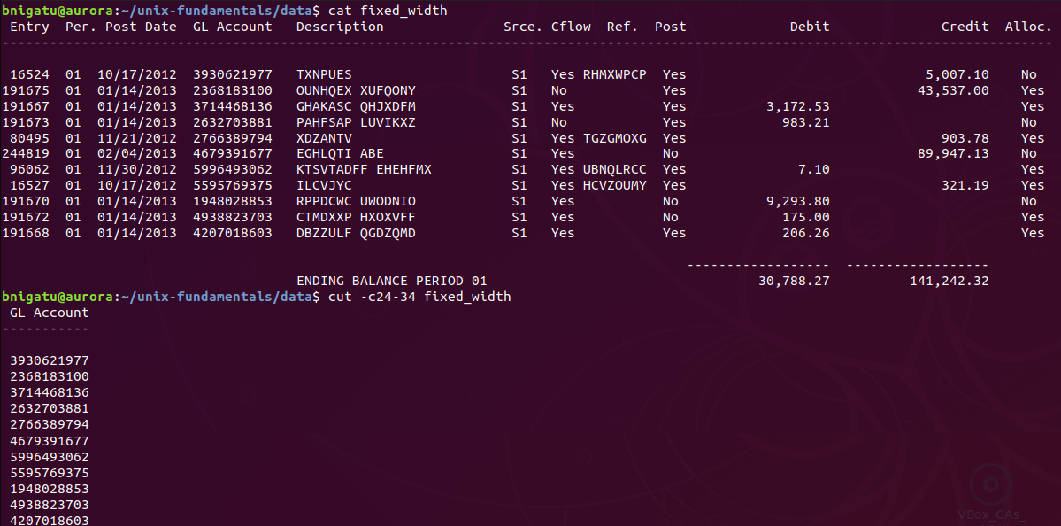
‘cut –c’ Example
cut –c can be used to extract a column from a fixed width column such as the one below

Slide 25
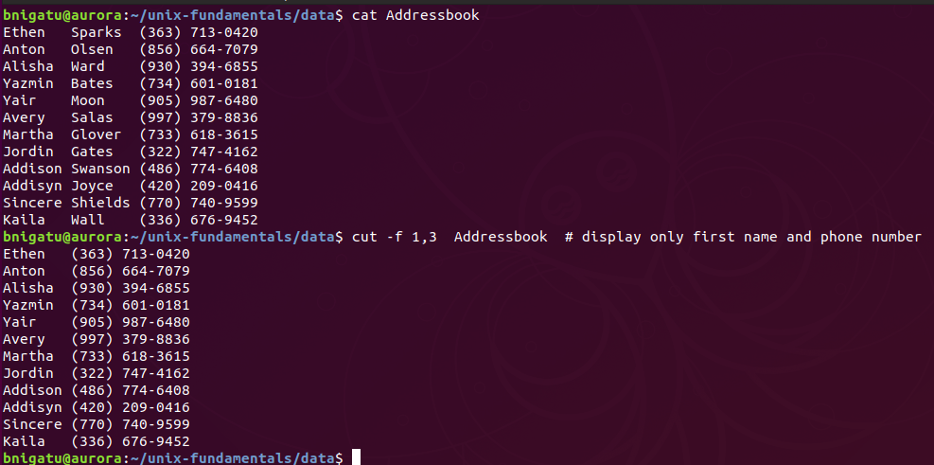
‘cut –d’ and ‘cut –f’ Examples
‘-f’ is cut the first field.
Display only the first
and third columns

Slide 26
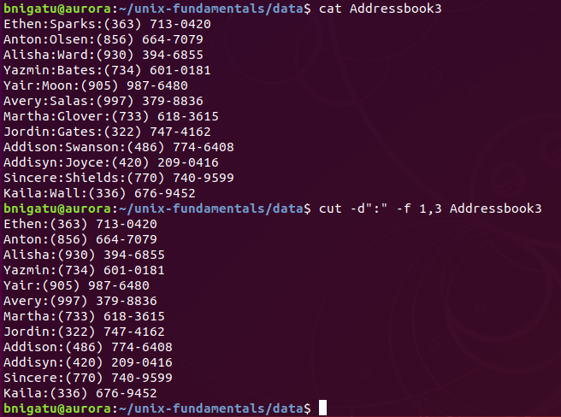
Another ‘cut –d –f’ Example
‘-d’ is cut the columns by field using some delimiter such as ‘:’
‘-f’ is cut the first field.

Slide 27
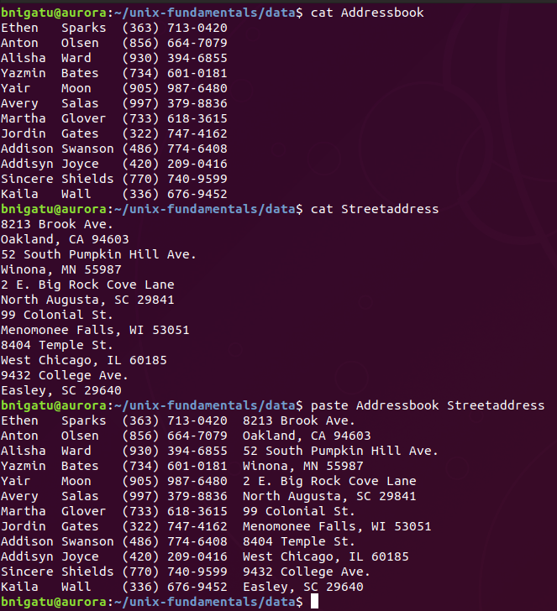
‘paste’ Pasting Files
‘paste’ helps to concatenate files by their columns.
The ‘-s’ option joins lines and the ‘-d’ option is nearly the same as ‘cut’; however, you can use multiple delimiters:

Slide 28
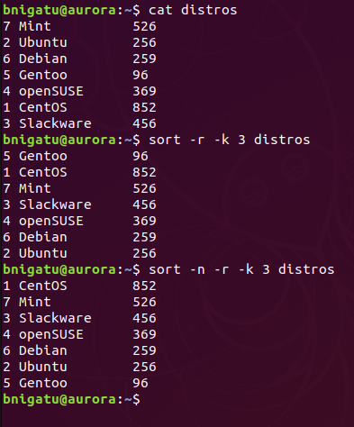
‘sort’ Ordering a File
Unlike ‘cut’ and ‘paste’, ‘sort’ uses the ‘-t’ as a delimiter
The ‘-k’ (meaning key)is used to define the field to sort on
Use ‘-r’ to sort in reverse order
Use ‘-n’ to sort as numeric
This is a simple 3-field list:

Slide 29
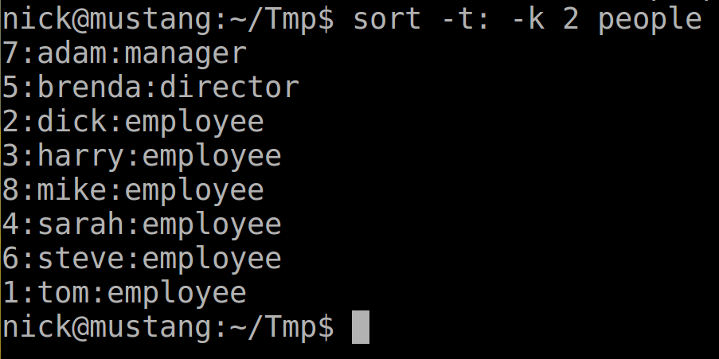
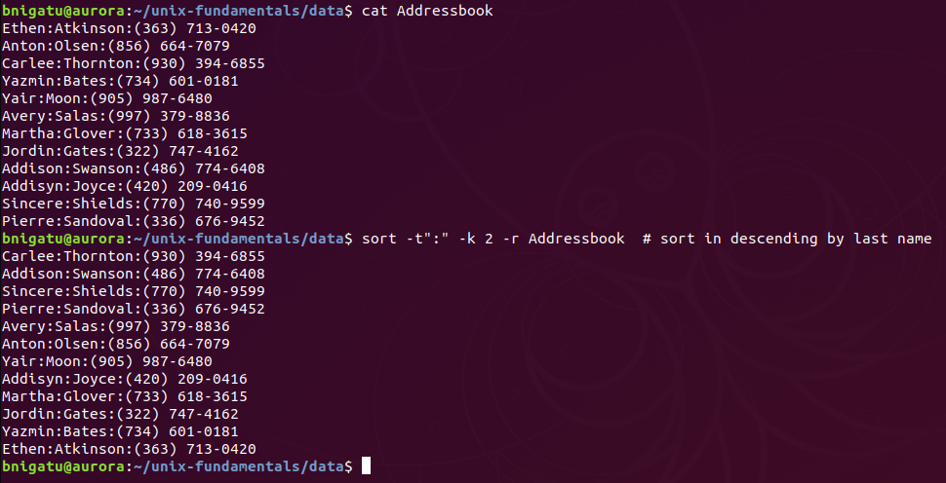
‘sort’ Example (-t)
‘-k 2’ defines the field
‘-r’ sort in revers order
The delimiter is ‘:’

Slide 30
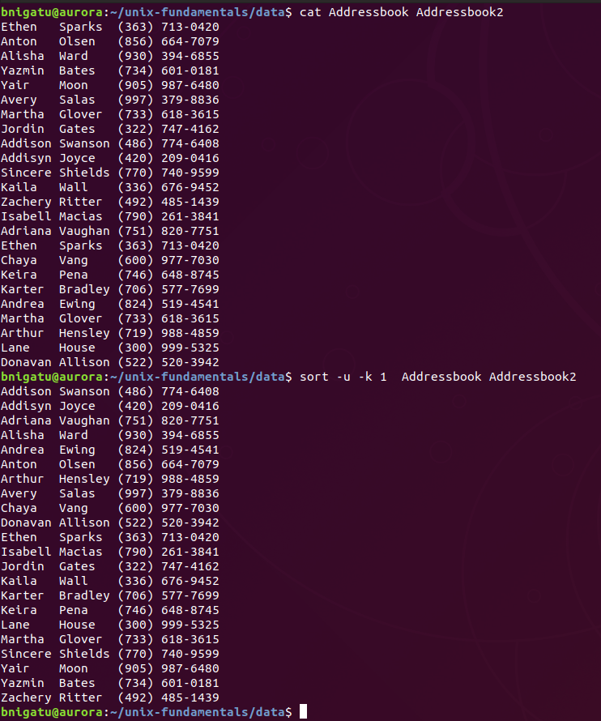
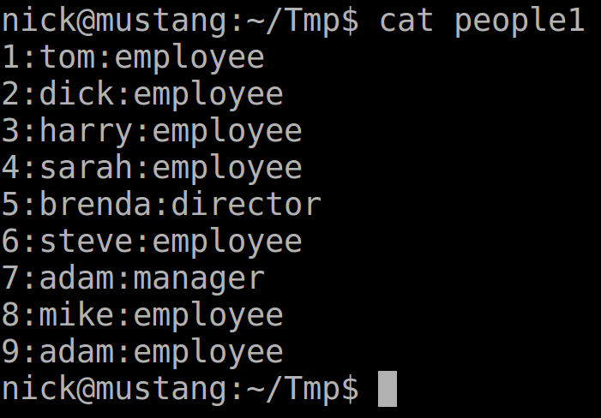
‘sort –u’ Example
Ethen 1
‘-u’ is used to remove repeated lines. In this example, it is used to remove a repeated name in column two.
Martha 1
Eth 2
Martha 2

Slide 31
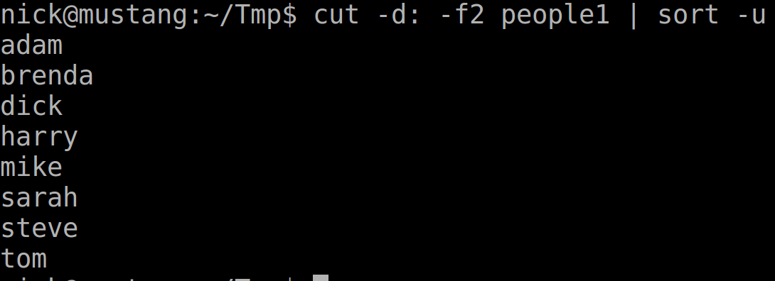
‘sort –u’ Example Continued
One Ethen removed
One Martha removed

Slide 32
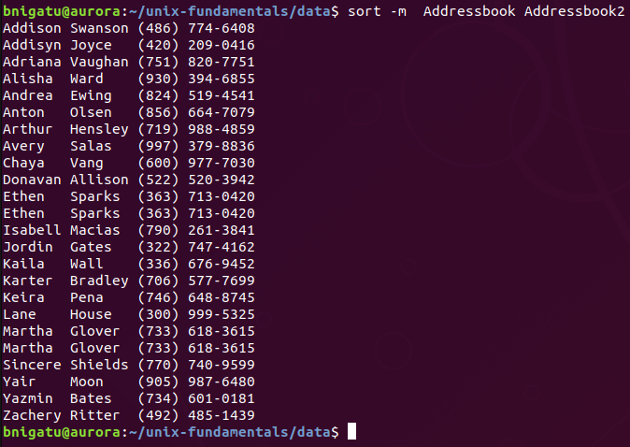
‘sort –m’ (merge) Example
The ‘-m’ option is merge already sorted list.

Slide 33
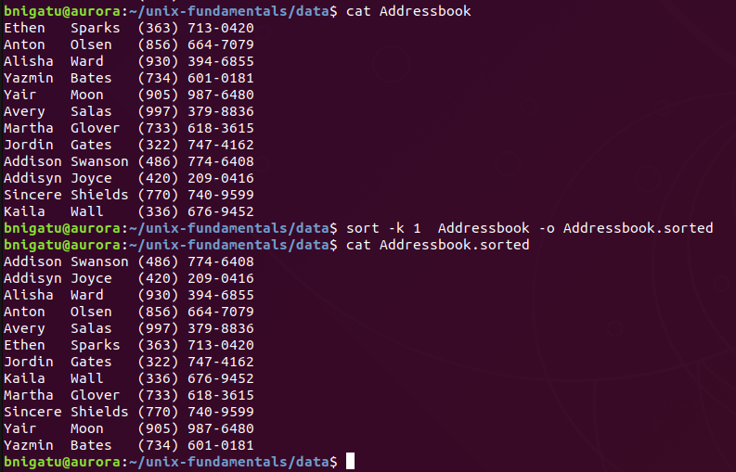
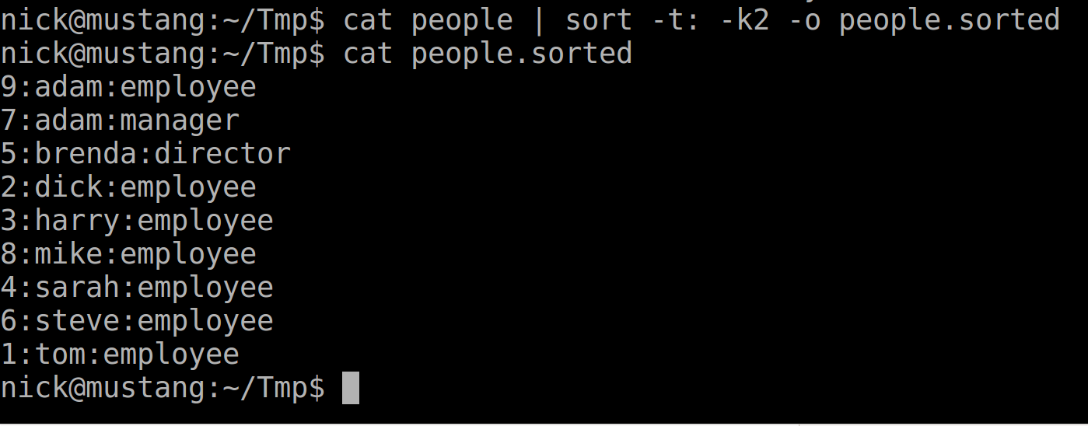
‘sort –o’ (output) Example
Output file

Slide 34
‘tr’ Translating Characters
‘tr’ stands for translate and is a filter that manipulates individual characters in a line
‘tr’ perform substitution, deletion and squeezing of repeated characters
‘tr’ accept only from standard input stdin and could not accept from command line argument
‘tr <options> <expression1> <expression2> < <standard input>’
By default, translates each character in <expression1> to its mapped counterpart in <expression2>
Example using the people file: ‘tr ‘ ’ ‘:’ < students | head –n 3’
In this example, the ‘ ’ space is replaced with the ‘:’
And piped to ‘head’ showing the first three entries

Slide 35
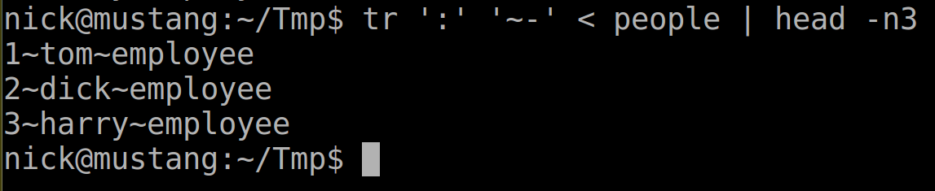
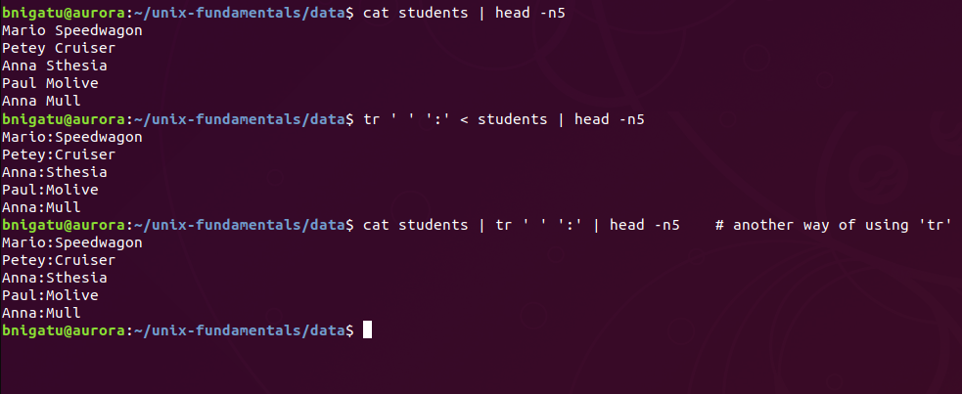
‘tr’ Example

Slide 36
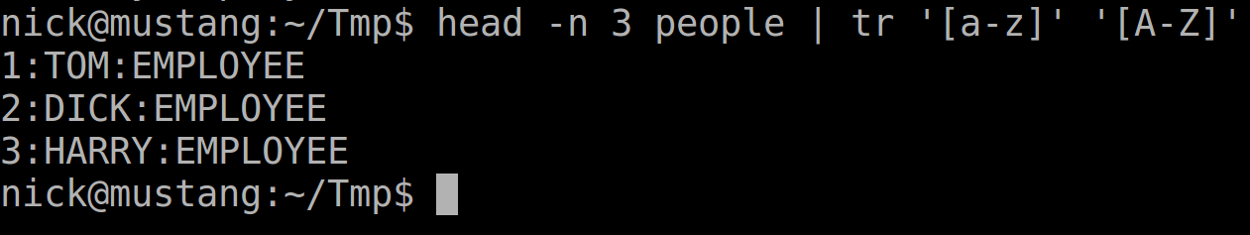
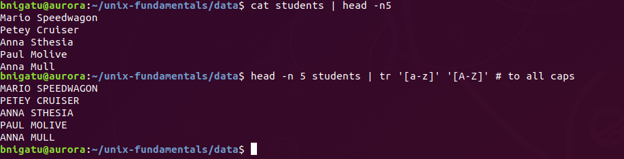
‘tr’ Change Case Example

Slide 37
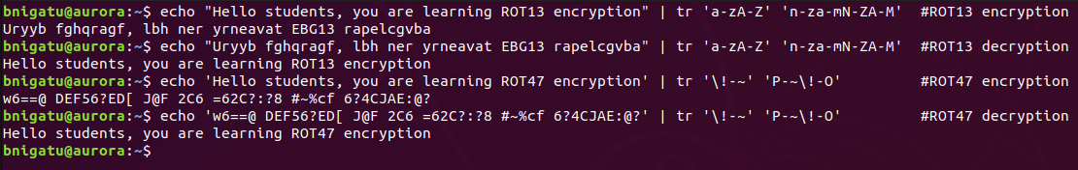
‘tr’ for simple encryption Example
ROT13 ("rotate by 13 places", sometimes hyphenated ROT-13) is a simple letter substitution cipher that replaces a letter with the 13th letter after it, in the alphabet. ROT13 is a special case of the Caesar cipher where the same function is used to encrypt and decrypt. https://en.wikipedia.org/wiki/ROT13
tr 'a-zA-Z' 'n-za-mN-ZA-M' #ROT13
tr '\!-~' 'P-~\!-O’ #ROT47

Slide 38
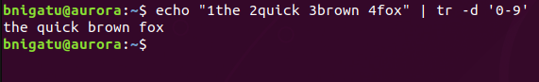
‘tr’ Deletion Example (-d)
Removing numbers from a text

Slide 39
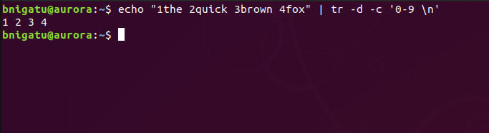
‘tr’ Complementing Example (-c)
In the following example we would like to keep numbers and new line and remove everything else

Slide 40
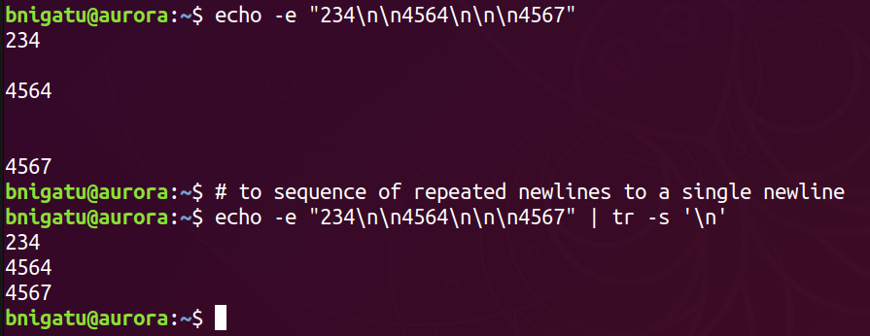
‘tr’ Squeezing Example (-s)
In the next example we will convert each sequence of repeated newlines to a single newline using tr -s

Slide 41
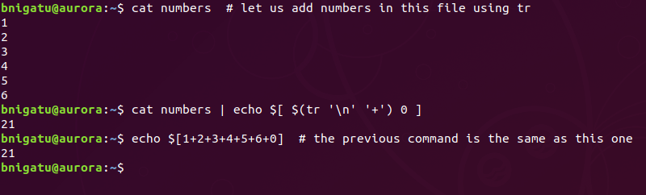
‘tr’ for numerical analysis
In this example we will perform a vertical sum of all numbers that are in the file numbers using tr
Notes:
Another way of arithmetic expansion is echo $(( $(tr '\n' '+' < numbers) 0 ))

